Slide 1
Solving Grad-Shafranof Equation

Slide 2
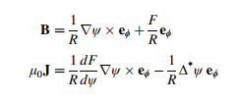

Grad-shafranov equation
$$μ_{0}R^{2}\frac{dp}{dψ}+F\frac{dF}{dψ}+Δ^{∗}ψ=0$$
With
$$Δ^{∗}ψ=R^{2}∇∙\left(\frac{∇ψ}{R^{2}}\right)=R^{2}∂_{R}\left(\frac{1}{R^{2}}∂_{R}ψ\right)+∂_{φ}^{2}ψ+∂_{z}^{2}ψ$$

Slide 3
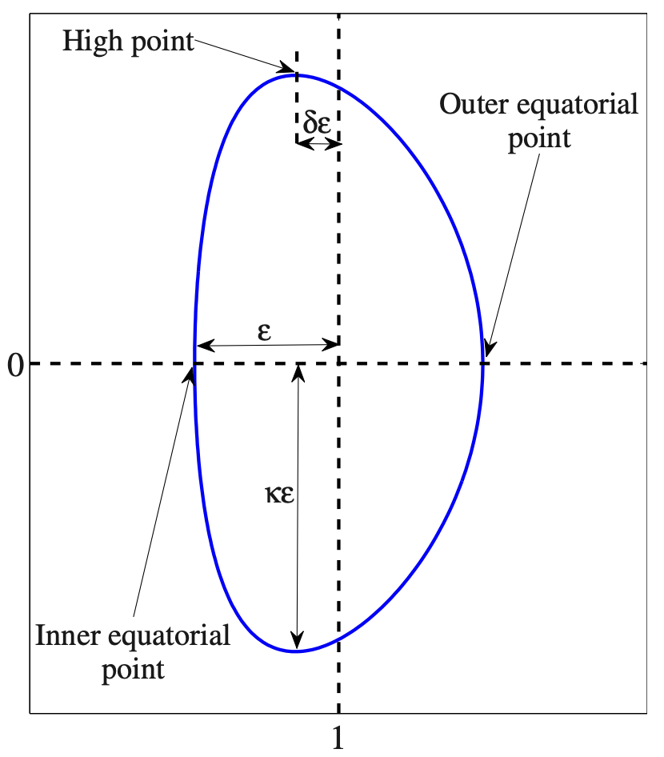
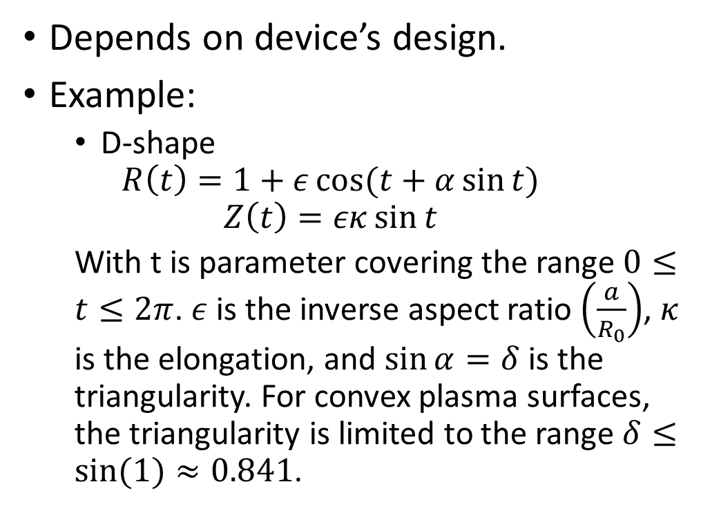
Boundary condition
Depends on device’s design.
Example:
D-shape
$$R\left(t\right)=1+ε\cos{(t+α\sin{t})}$$
$$Z\left(t\right)=εκ\sin{t}$$
With t is parameter covering the range $0≤t≤2π$. $ε$ is the inverse aspect ratio $\left(\frac{a}{R_{0}}\right)$, $κ$ is the elongation, and $\sin{α}=δ$ is the triangularity. For convex plasma surfaces, the triangularity is limited to the range $δ≤sin⁡(1)≈0.841$.

Slide 4
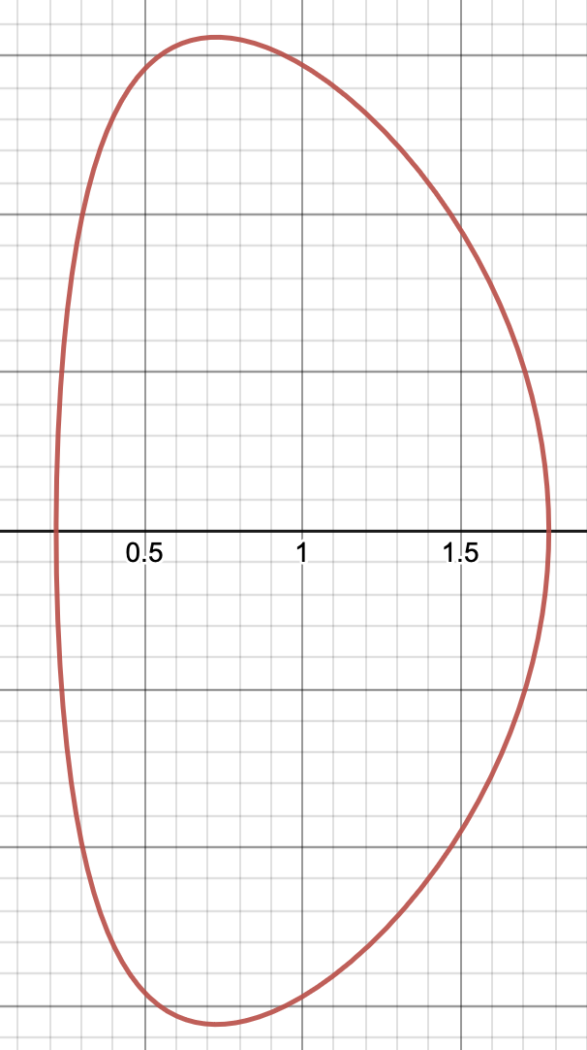

Boundary condition
Example for $ε=0.78, α=0.3576, κ=2$

Slide 5
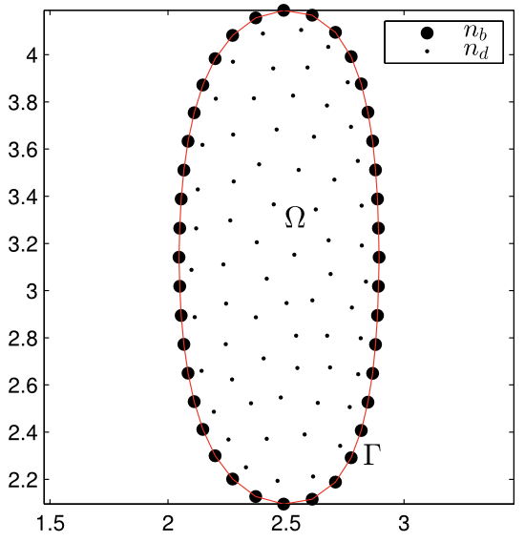
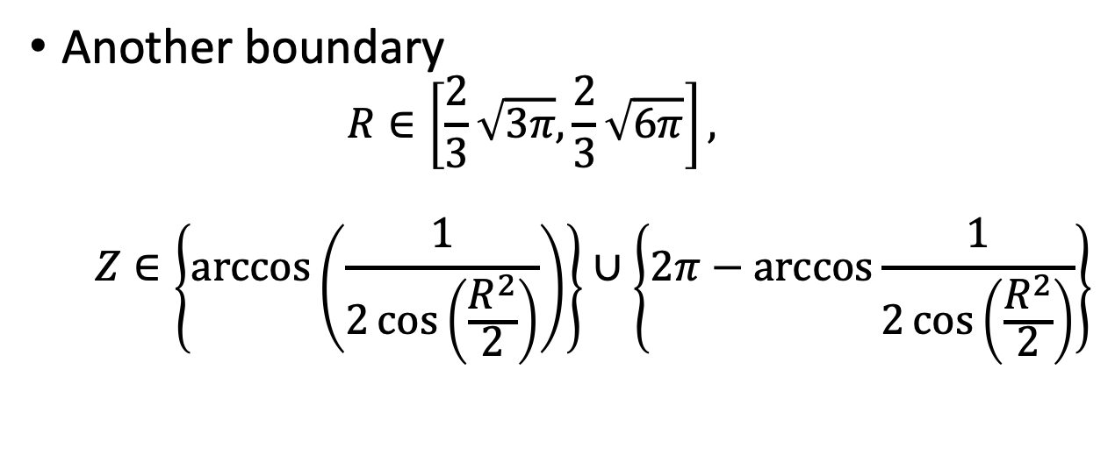
Another boundary
$$R∈\left[\frac{2}{3}\sqrt{3π},\frac{2}{3}\sqrt{6π}\right],$$
$$Z∈\left\{\arccos\left(\frac{1}{2\cos\left(\frac{R^{2}}{2}\right)}\right)\right\}∪\left\{2π−\arccos{\frac{1}{2\cos\left(\frac{R^{2}}{2}\right)}}\right\}$$

Slide 6
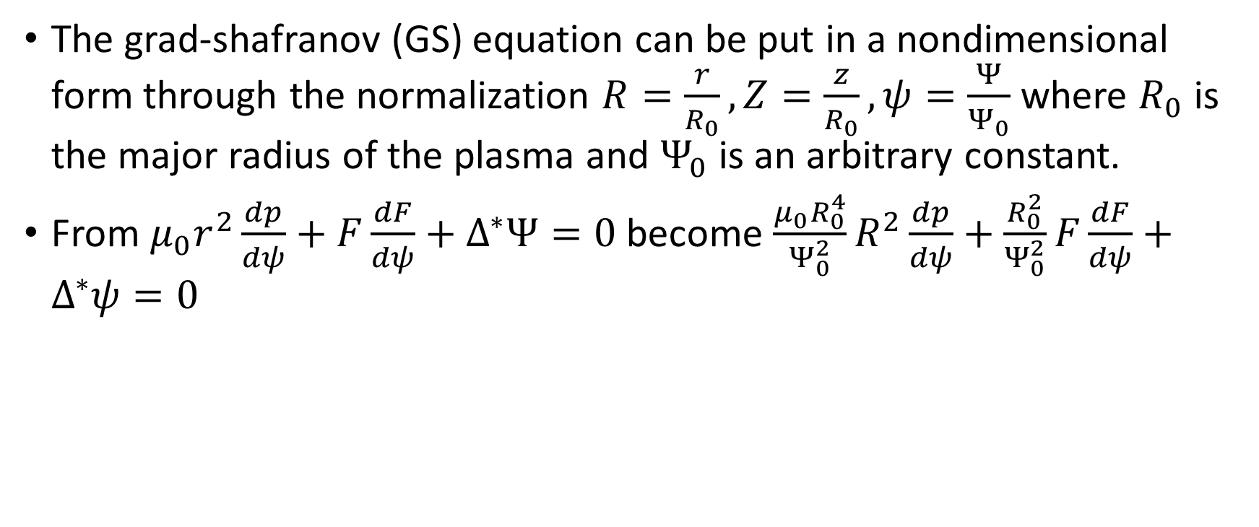
Nondimensionalizing
The grad-shafranov (GS) equation can be put in a nondimensional form through the normalization $R=\frac{r}{R_{0}},Z=\frac{z}{R_{0}},ψ=\frac{Ψ}{Ψ_{0}}$ where $R_{0}$ is the major radius of the plasma and $Ψ_{0}$ is an arbitrary constant.
From $μ_{0}r^{2}\frac{dp}{dψ}+F\frac{dF}{dψ}+Δ^{∗}Ψ=0$ become $\frac{μ_{0}R_{0}^{4}}{Ψ_{0}^{2}}R^{2}\frac{dp}{dψ}+\frac{R_{0}^{2}}{Ψ_{0}^{2}}F\frac{dF}{dψ}+Δ^{∗}ψ=0$

Slide 7
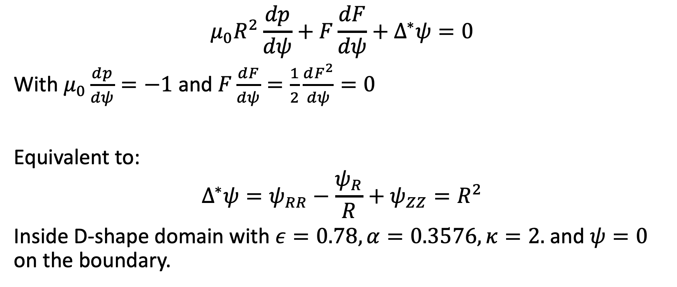
Solov’ev Equilibrium
$$μ_{0}R^{2}\frac{dp}{dψ}+F\frac{dF}{dψ}+Δ^{∗}ψ=0$$
With $μ_{0}\frac{dp}{dψ}=−1$ and $F\frac{dF}{dψ}=\frac{1}{2}\frac{dF^{2}}{dψ}=0$
Equivalent to:
$$Δ^{∗}ψ=ψ_{RR}−\frac{ψ_{R}}{R}+ψ_{ZZ}=R^{2}$$
Inside D-shape domain with $ε=0.78, α=0.3576, κ=2.$ and $ψ=0$ on the boundary.

Slide 8
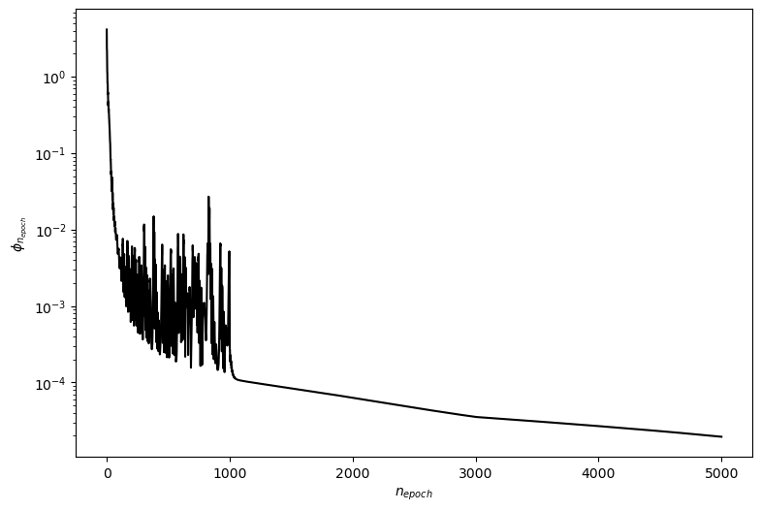
Solov’ev equilibrium
Using PINN with 8 layers, 20 neuron/layer and tanh activation function, after 5000 iteration the error is:

Slide 9
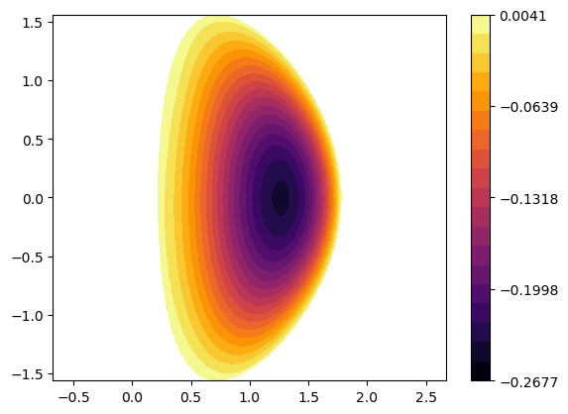
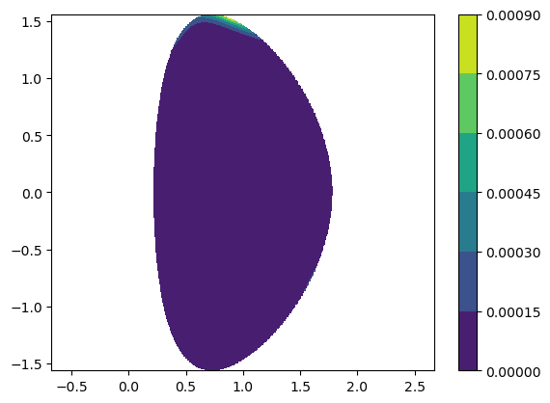
Solov’ev equilibrium
Approximate solution:
Differential residual:

Slide 10
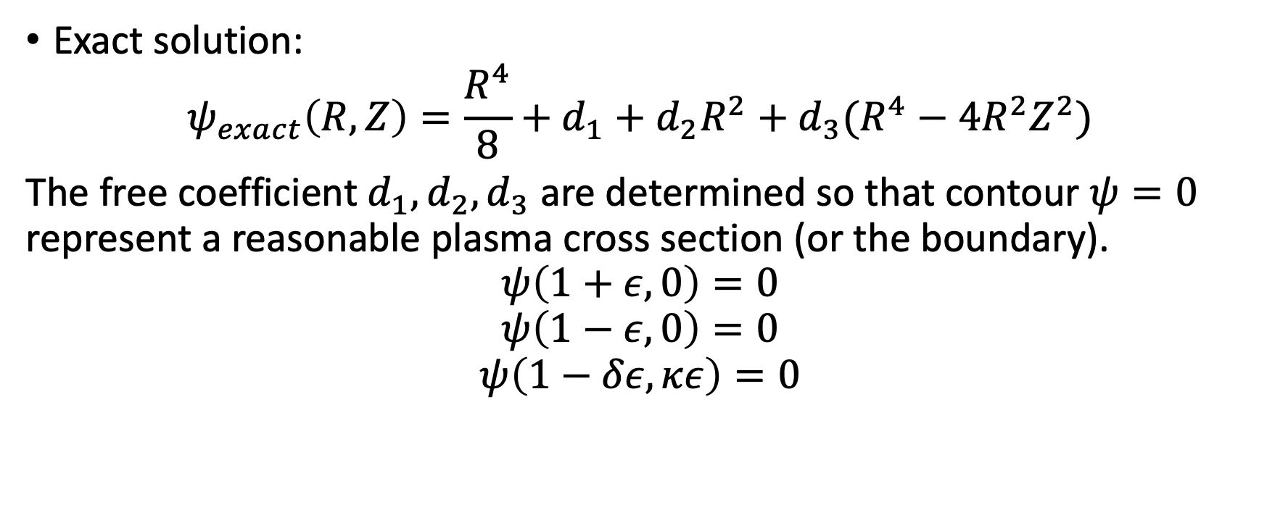
Analytic solution of solov’ev equilibrium
Exact solution:
$$ψ_{exact}\left(R,Z\right)=\frac{R^{4}}{8}+d_{1}+d_{2}R^{2}+d_{3}(R^{4}−4R^{2}Z^{2})$$
The free coefficient $d_{1},d_{2},d_{3}$ are determined so that contour $ψ=0$ represent a reasonable plasma cross section (or the boundary).
$$ψ\left(1+ε,0\right)=0$$
$$ψ\left(1−ε,0\right)=0$$
$$ψ\left(1−δε,κε\right)=0$$

Slide 11
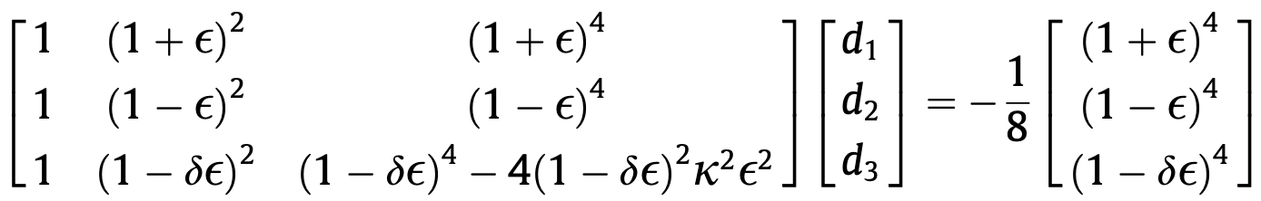
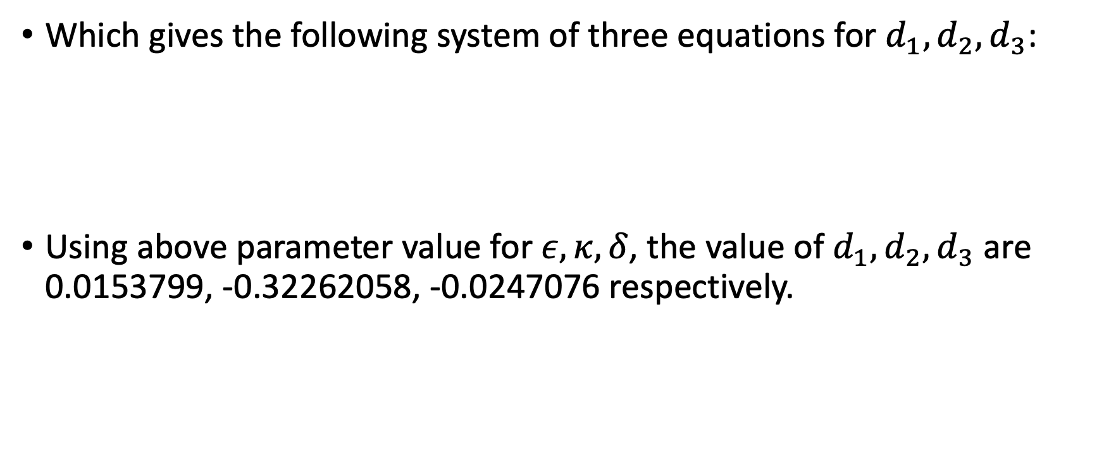
Analytic solution of solovev equilibrium
Which gives the following system of three equations for $d_{1},d_{2},d_{3}$:
Using above parameter value for $ε,κ,δ$, the value of $d_{1},d_{2},d_{3}$ are 0.0153799, -0.32262058, -0.0247076 respectively.

Slide 12
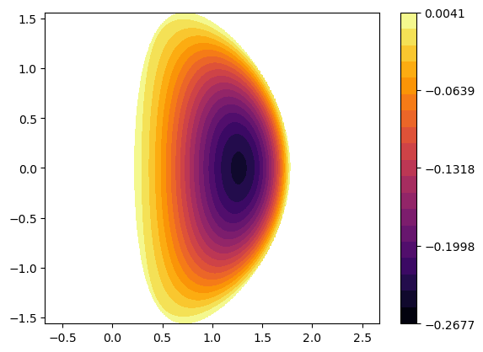
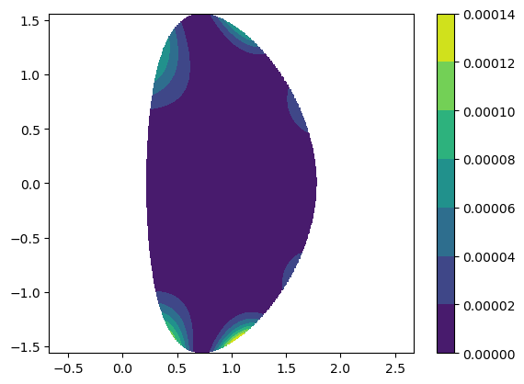
analytic solution of solovev equilibrium
Analytic solution:
Absolute difference between approximate and analytic solution

Slide 13

GS-equation with linear RHS
$$Δ^{∗}ψ=−\left(μ_{0}R^{2}\frac{dp}{dψ}+F\frac{dF}{dψ}\right)$$
With $μ_{0}R^{2}\frac{dp}{dψ}+F\frac{dF}{dψ}=c_{0}\left(c_{1}+c_{2}R^{2}\right)ψ$, the equation become:
$$c_{0}\left(c_{1}+c_{2}R^{2}\right)ψ+Δ^{∗}ψ=0$$

Slide 14
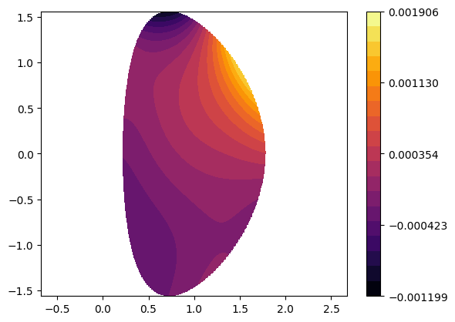

$$−1\left(0.5+0.5R^{2}\right)ψ+Δ^{∗}ψ=0$$
The solution obtain from PINN:

Slide 15
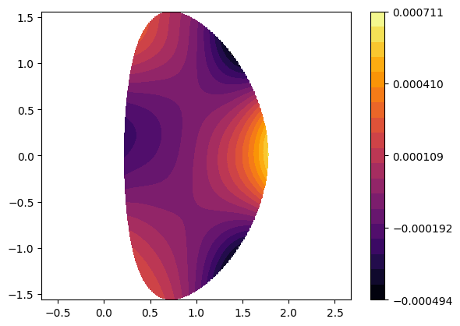

$$1\left(0.5+0.5R^{2}\right)ψ+Δ^{∗}ψ=0$$
The solution obtain from PINN:

Slide 16
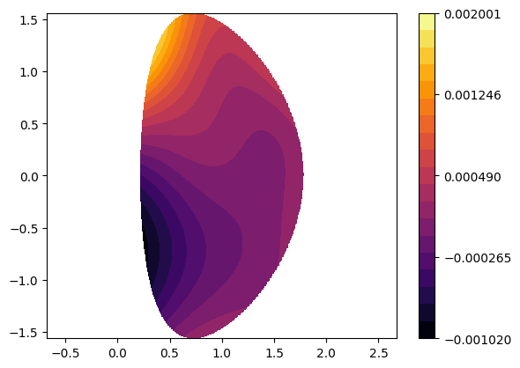

$$−10\left(0.5+0.5R^{2}\right)ψ+Δ^{∗}ψ=0$$
The solution obtain from PINN:

Slide 17

We need consider it as eigen value problem
$$λ\left(c_{1}+c_{2}R^{2}\right)ψ+Δ^{∗}ψ=0$$
Based on Pataki (2013), we only treat the question of finding the smallest eigenvalue and its associated eigenfunction because almost all magnetic fusion confinement problems of interest have a single extremum of $ψ$ within the plasma region.

Slide 18
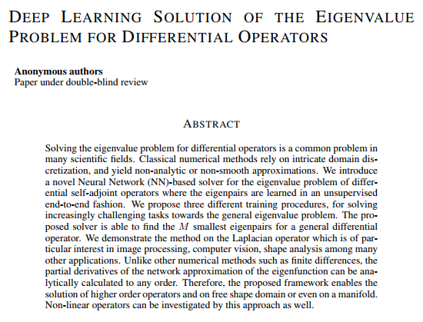

literature solving eigenvalue problem using NN

Slide 19
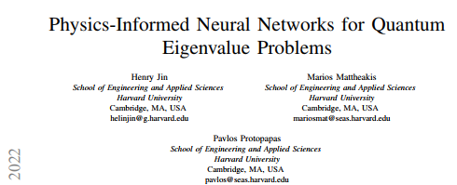
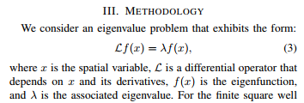
literature solving eigenvalue problem using NN

Slide 20
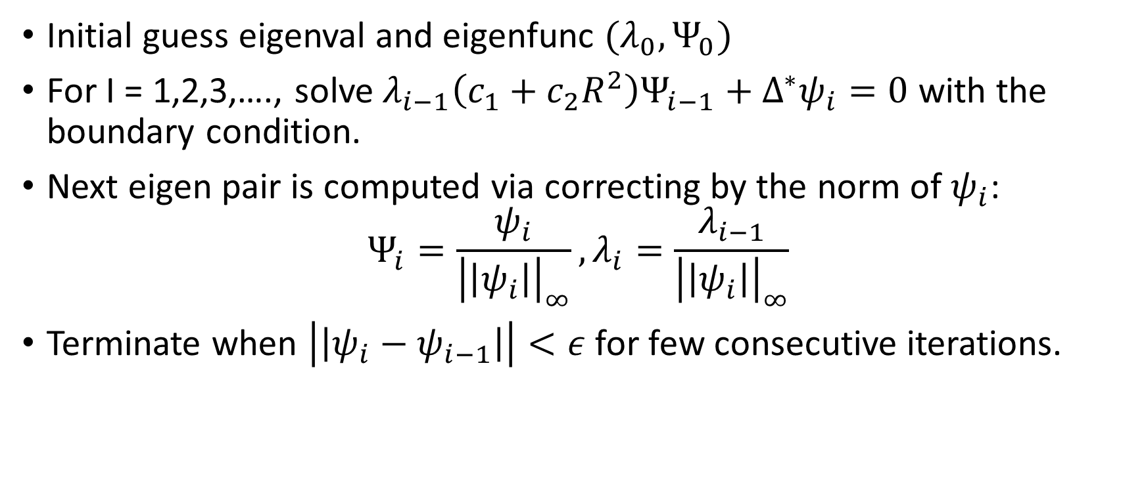
“Power Method”
Initial guess eigenval and eigenfunc $(λ_{0},Ψ_{0})$
For I = 1,2,3,…., solve $λ_{i−1}\left(c_{1}+c_{2}R^{2}\right)Ψ_{i−1}+Δ^{∗}ψ_{i}=0$ with the boundary condition.
Next eigen pair is computed via correcting by the norm of $ψ_{i}$:
$$Ψ_{i}=\frac{ψ_{i}}{{\left|\left|ψ_{i}\right|\right|}_{∞}}, λ_{i}=\frac{λ_{i−1}}{{\left|\left|ψ_{i}\right|\right|}_{∞}}$$
Terminate when $\left|\left|ψ_{i}−ψ_{i−1}\right|\right|<ε$ for few consecutive iterations.

Slide 21
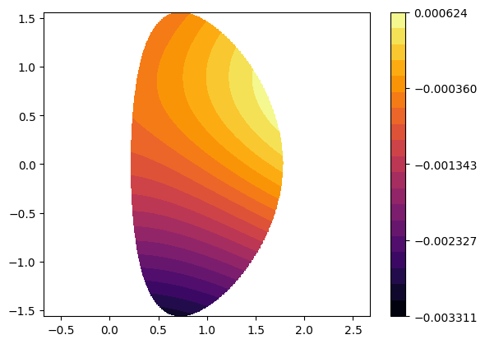
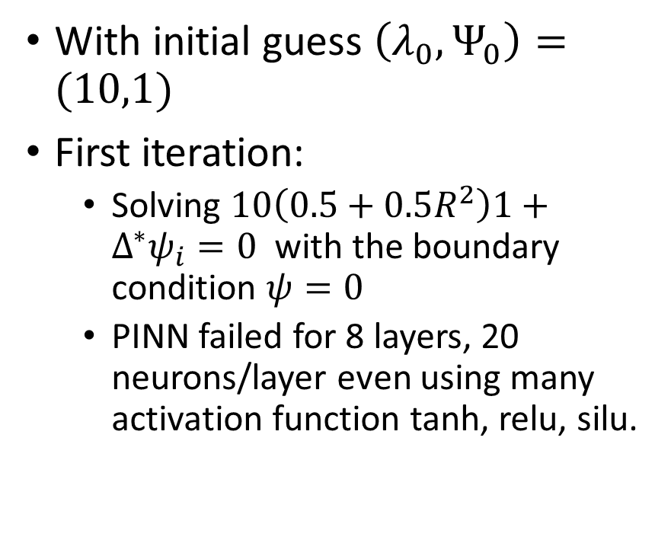
Finding eigenpair using “Power Method”
With initial guess $\left(λ_{0},Ψ_{0}\right)=(10,1)$
First iteration:
Solving $10\left(0.5+0.5R^{2}\right)1+Δ^{∗}ψ_{i}=0$ with the boundary condition $ψ=0$
PINN failed for 8 layers, 20 neurons/layer even using many activation function tanh, relu, silu.

Slide 22
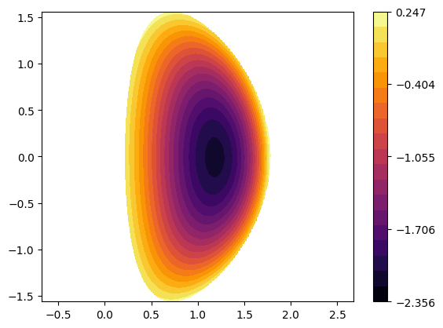
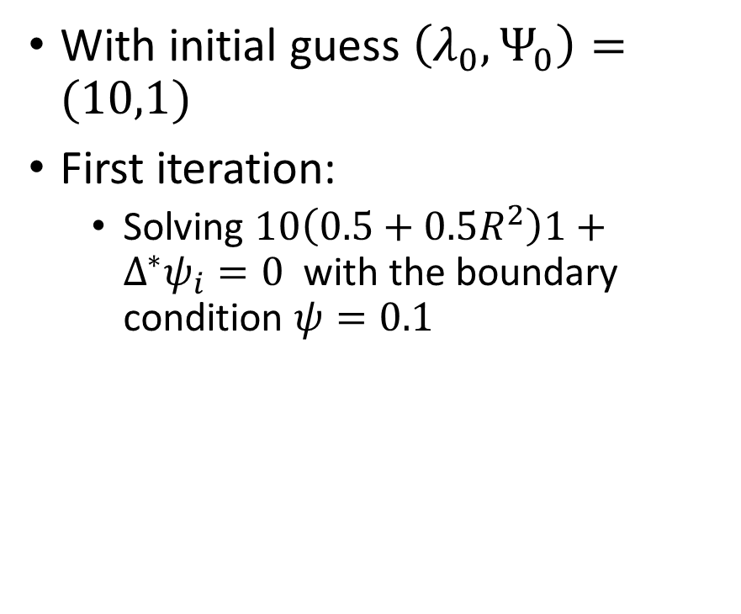
Finding eigenpair using “Power Method”
With initial guess $\left(λ_{0},Ψ_{0}\right)=(10,1)$
First iteration:
Solving $10\left(0.5+0.5R^{2}\right)1+Δ^{∗}ψ_{i}=0$ with the boundary condition $ψ=0.1$

Slide 23
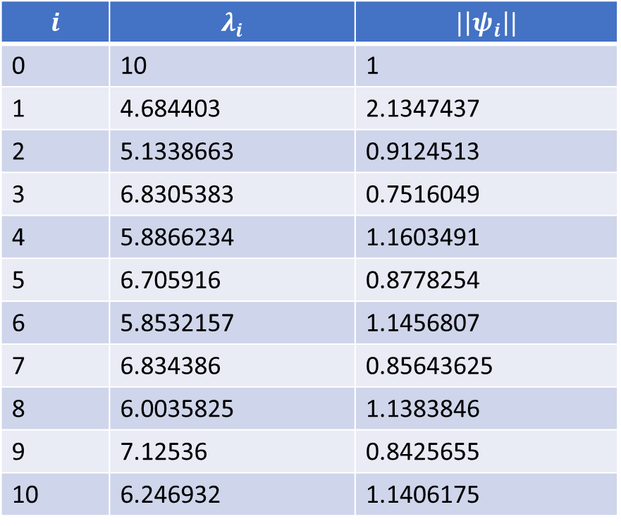
Result
$$i$$ | $$λ_{i}$$ | $$|\left|ψ_{i}\right||$$
0 | 10 | 1
1 | 4.684403 | 2.1347437
2 | 5.1338663 | 0.9124513
3 | 6.8305383 | 0.7516049
4 | 5.8866234 | 1.1603491
5 | 6.705916 | 0.8778254
6 | 5.8532157 | 1.1456807
7 | 6.834386 | 0.85643625
8 | 6.0035825 | 1.1383846
9 | 7.12536 | 0.8425655
10 | 6.246932 | 1.1406175

Slide 24
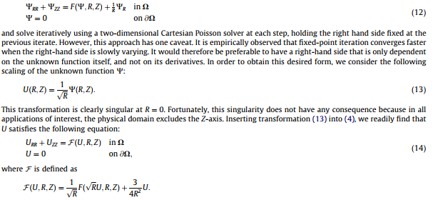
Implement Transformation

Slide 25
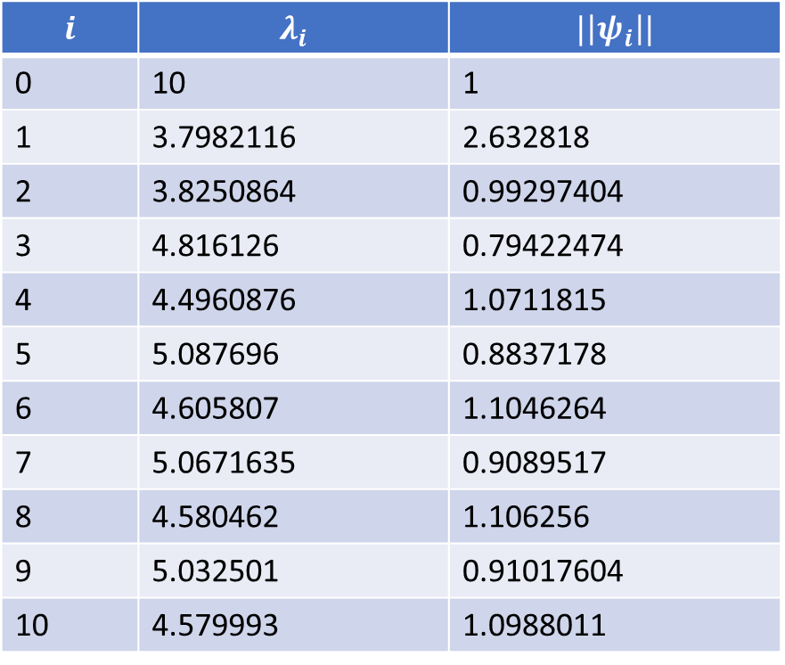
Result
$$i$$ | $$λ_{i}$$ | $$|\left|ψ_{i}\right||$$
0 | 10 | 1
1 | 3.7982116 | 2.632818
2 | 3.8250864 | 0.99297404
3 | 4.816126 | 0.79422474
4 | 4.4960876 | 1.0711815
5 | 5.087696 | 0.8837178
6 | 4.605807 | 1.1046264
7 | 5.0671635 | 0.9089517
8 | 4.580462 | 1.106256
9 | 5.032501 | 0.91017604
10 | 4.579993 | 1.0988011

